Slide 1

Optimization Algorithms
Understanding
mini-batch
gradient descent
deeplearning.ai

Slide 2
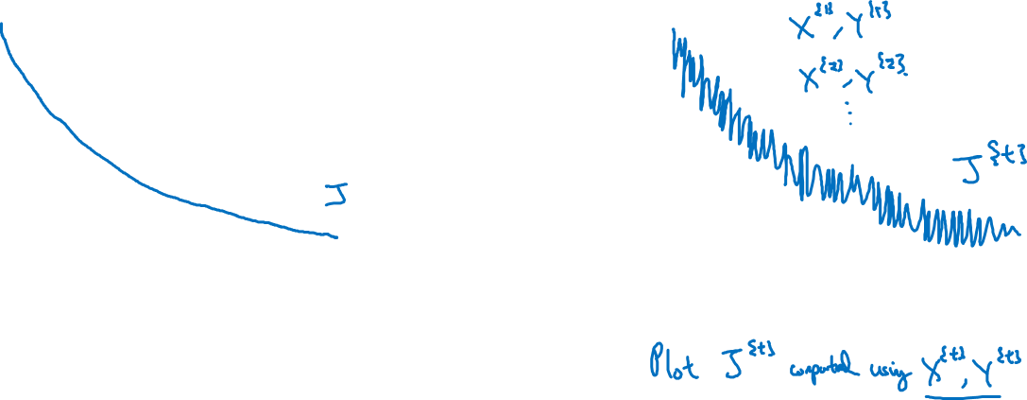
Training with mini batch gradient descent
Batch gradient descent
Mini-batch gradient descent
cost
cost
# iterations
mini batch # (t)

Slide 3
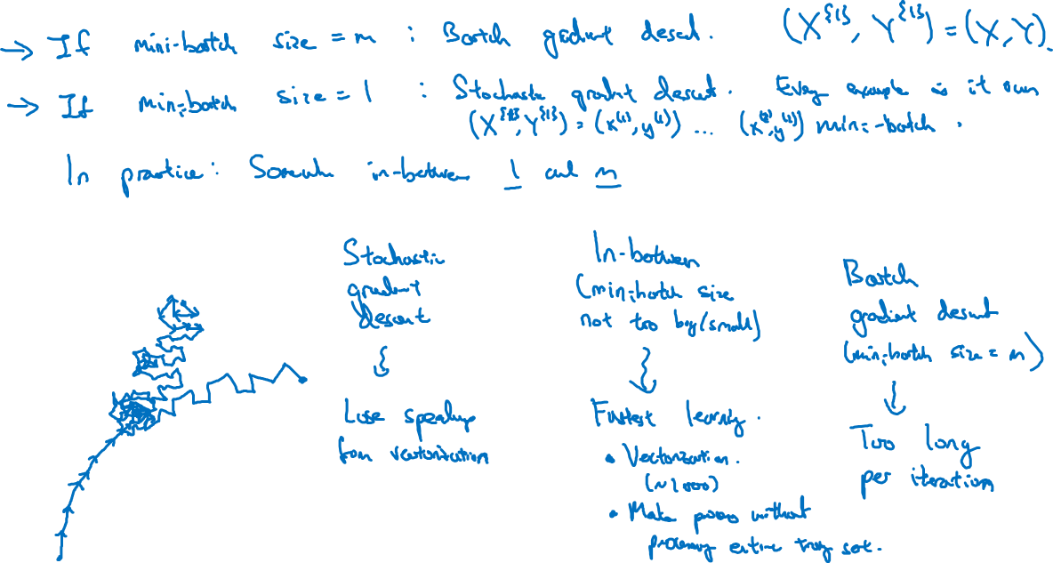
Choosing your mini-batch size

Slide 4
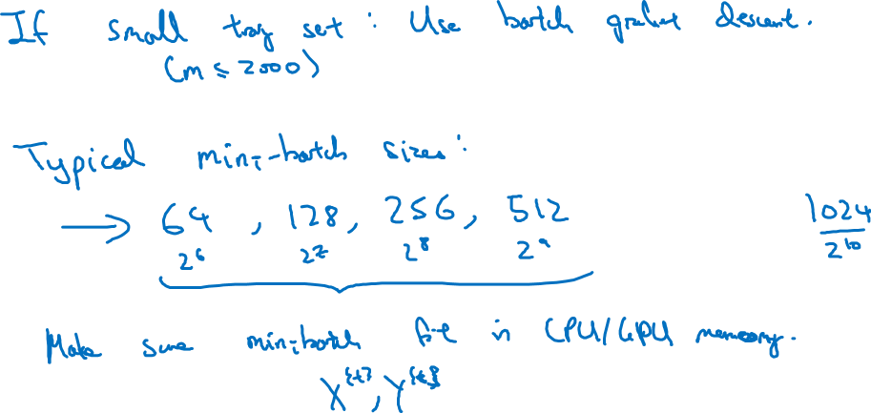
Choosing your mini-batch size

Slide 5
Optimization Algorithms
Exponentially weighted averages
deeplearning.ai

Slide 6

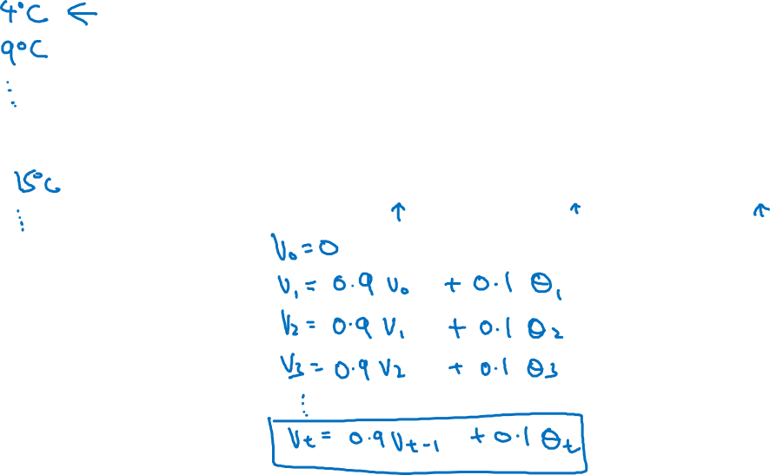
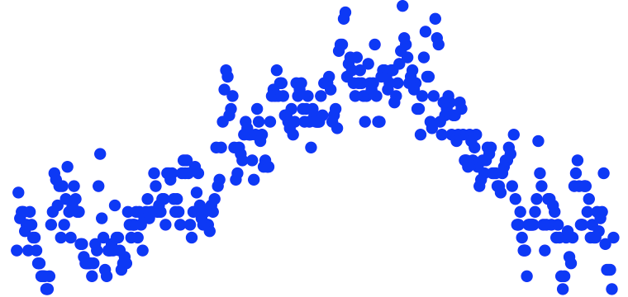
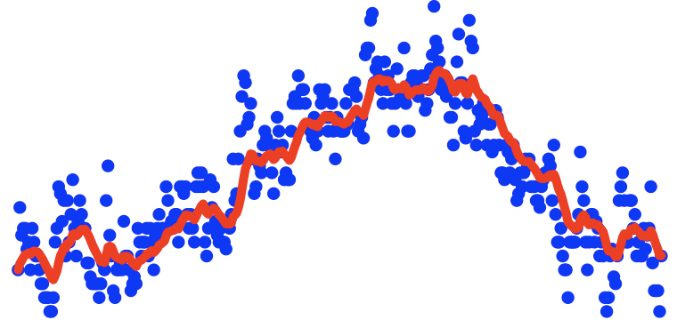




Temperature in London
temperature
.
.
.
days
.
.
.

Slide 7
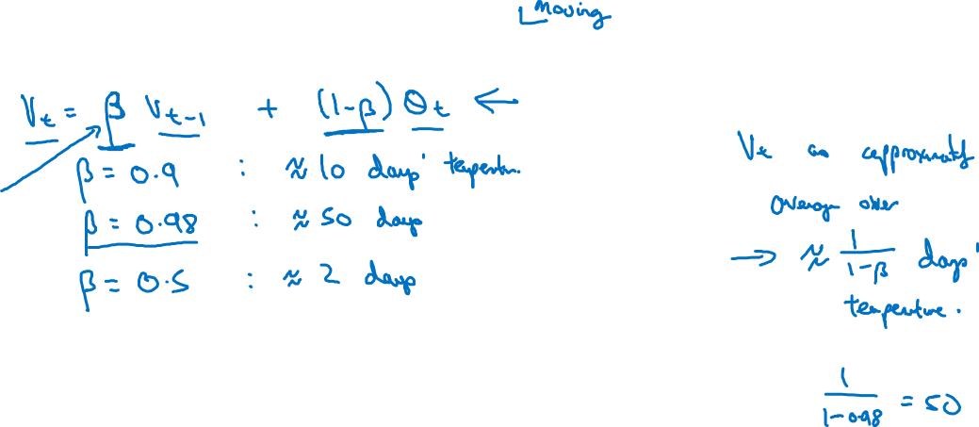
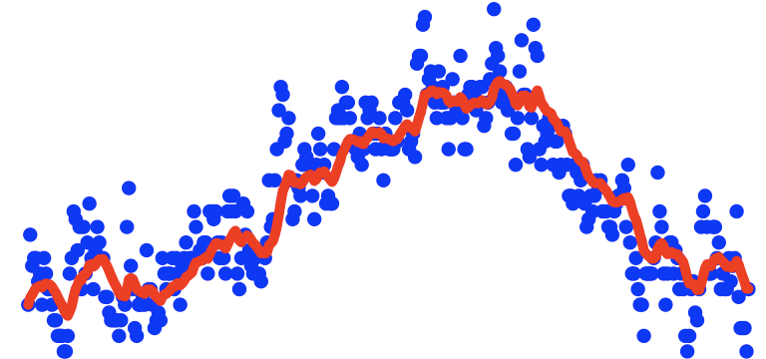
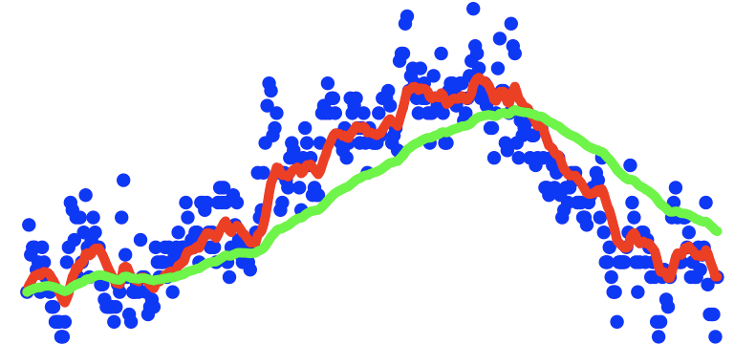
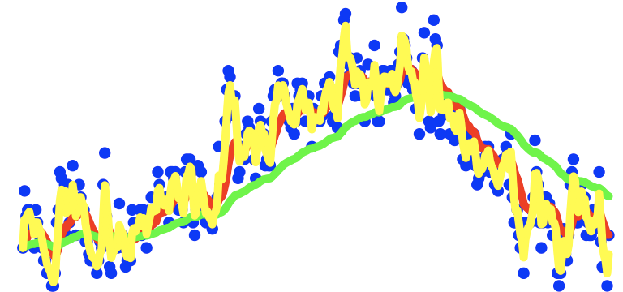
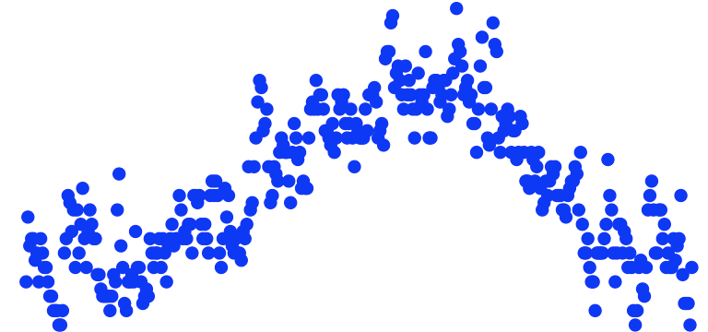
Exponentially weighted averages
temperature
days

Slide 8
Optimization Algorithms
Understanding exponentially weighted averages
deeplearning.ai

Slide 9

Exponentially weighted averages
temperature
days

Slide 10

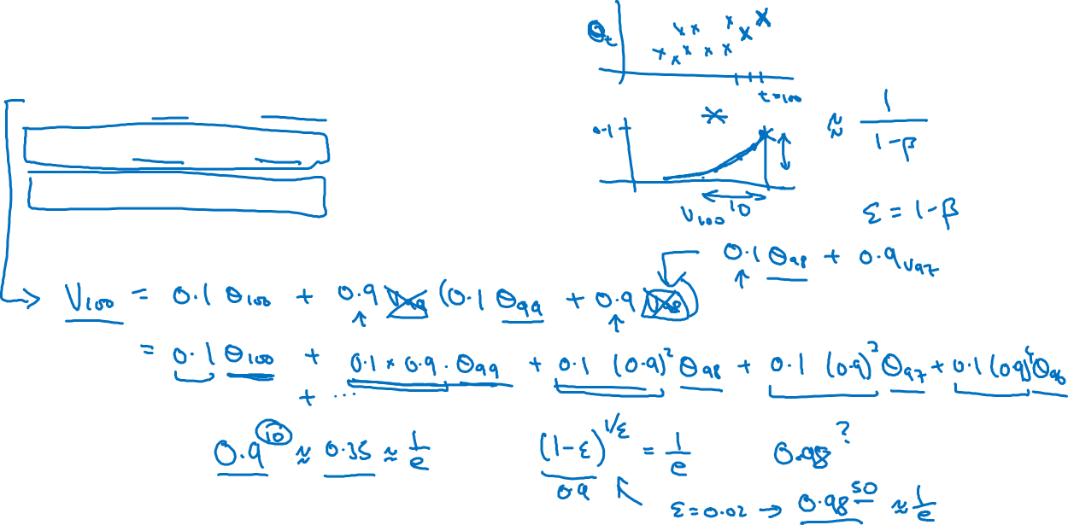




Exponentially weighted averages

Slide 11
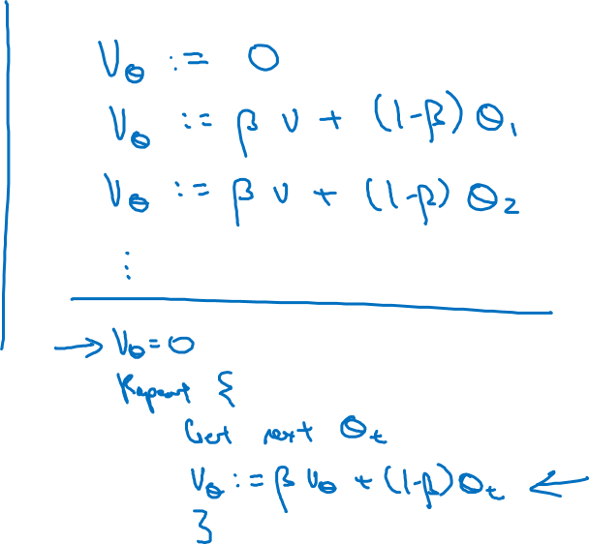





Implementing exponentially weighted averages

Slide 12
Optimization Algorithms
Bias correction
in exponentially
weighted average
deeplearning.ai

Slide 13
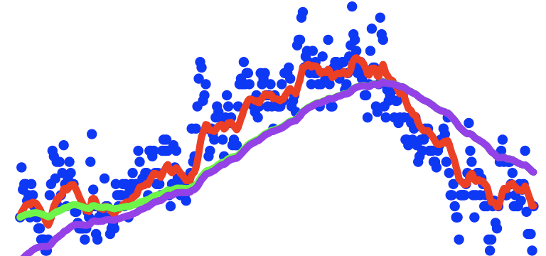
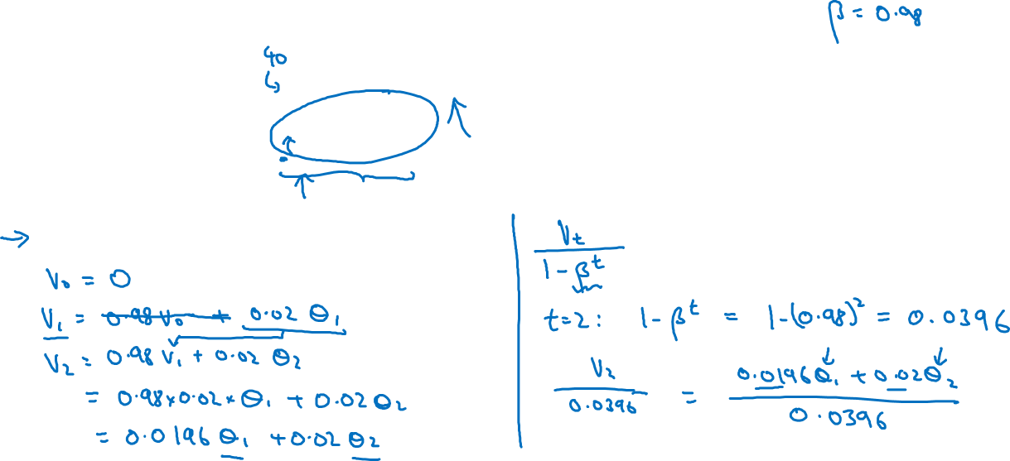

Bias correction
temperature
days

Slide 14
Optimization Algorithms
Gradient descent with momentum
deeplearning.ai

Slide 15
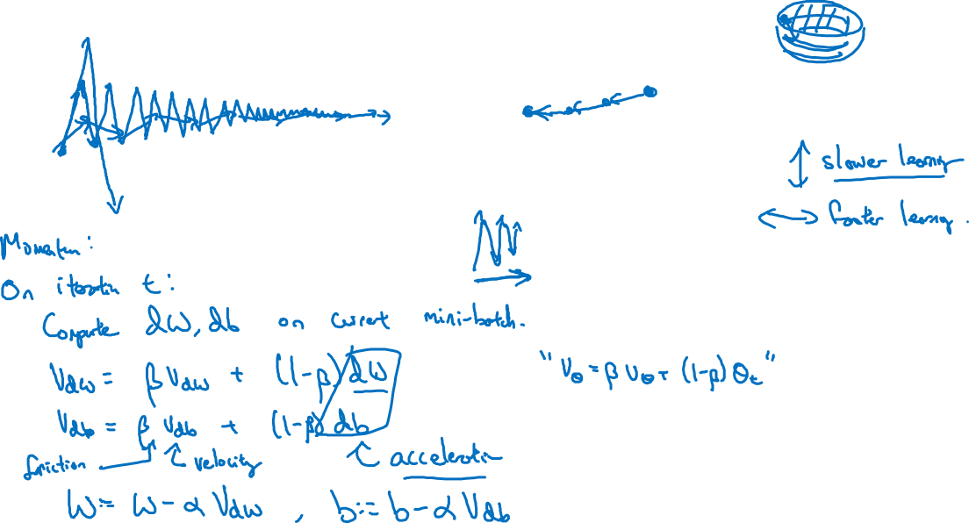
Gradient descent example
deeplearning.ai

Slide 16
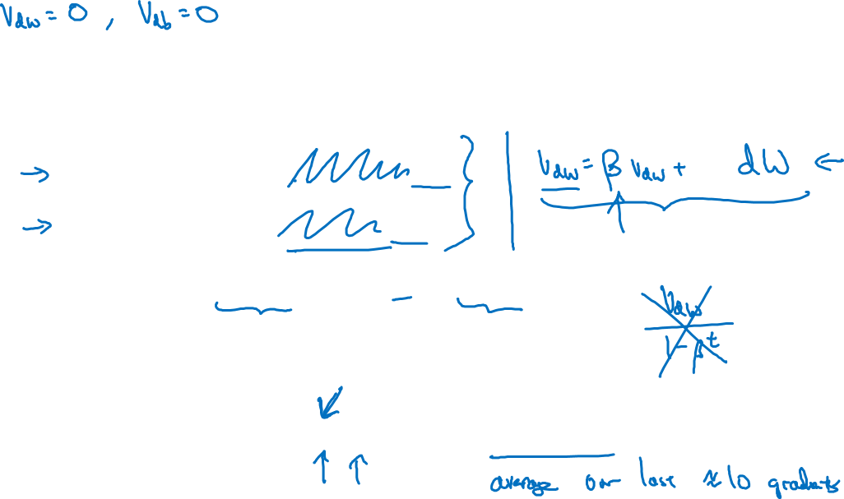





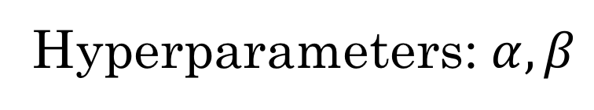

Implementation details
Compute on the current mini-batch
Hyperparameters:

Slide 17
Optimization Algorithms
RMSprop
deeplearning.ai

Slide 18
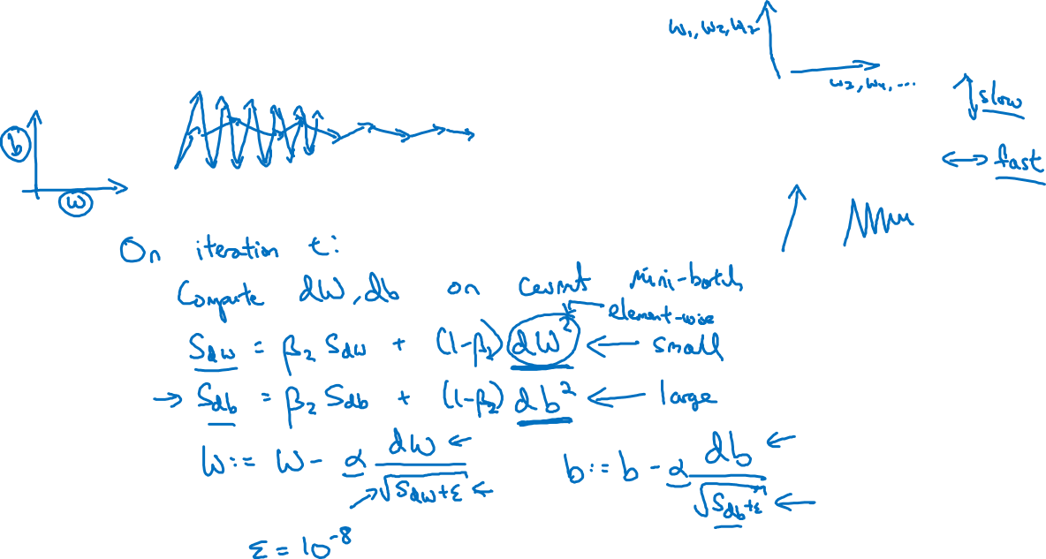
RMSprop

Slide 19
Optimization Algorithms
Adam optimization
algorithm
deeplearning.ai

Slide 20
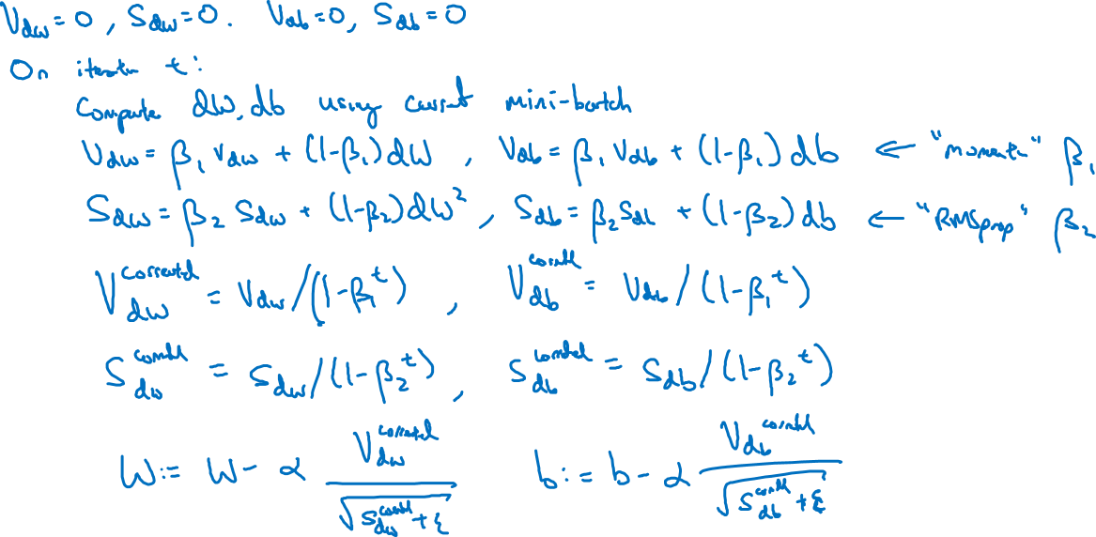
Adam optimization algorithm
yhat = np.array([.9, 0.2, 0.1, .4, .9])

Slide 21
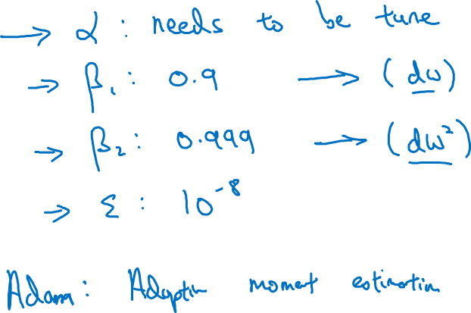

Hyperparameters choice:
Adam Coates

Slide 22
Optimization Algorithms
Learning rate
decay
deeplearning.ai

Slide 23
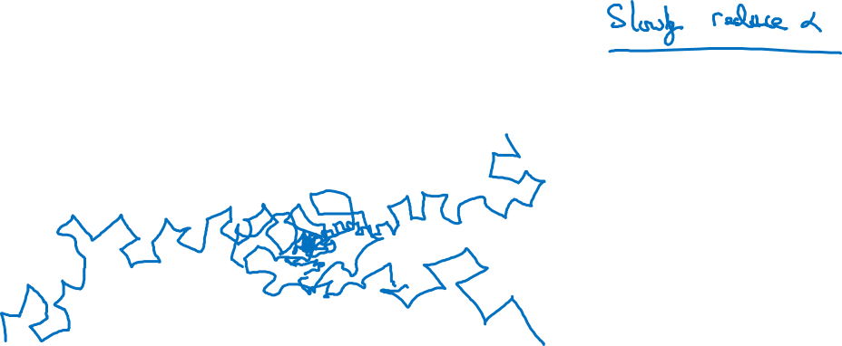
Learning rate decay

Slide 24
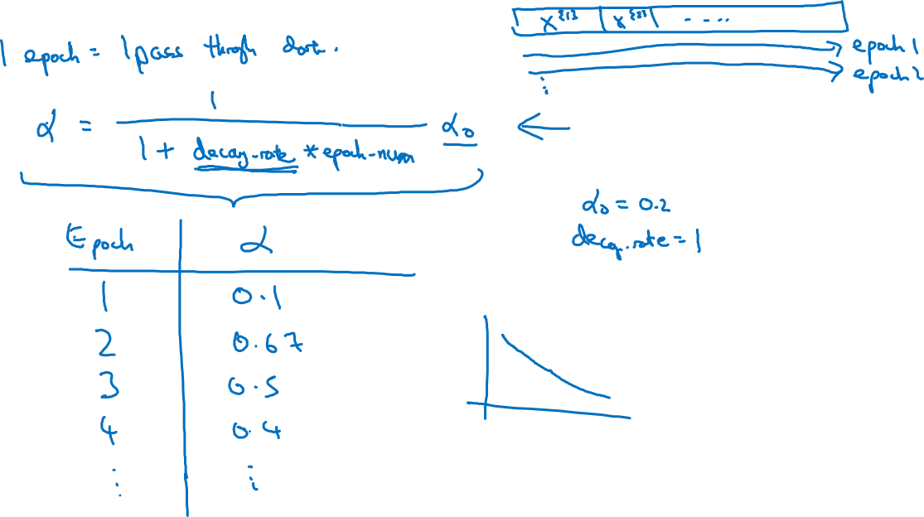
Learning rate decay

Slide 25
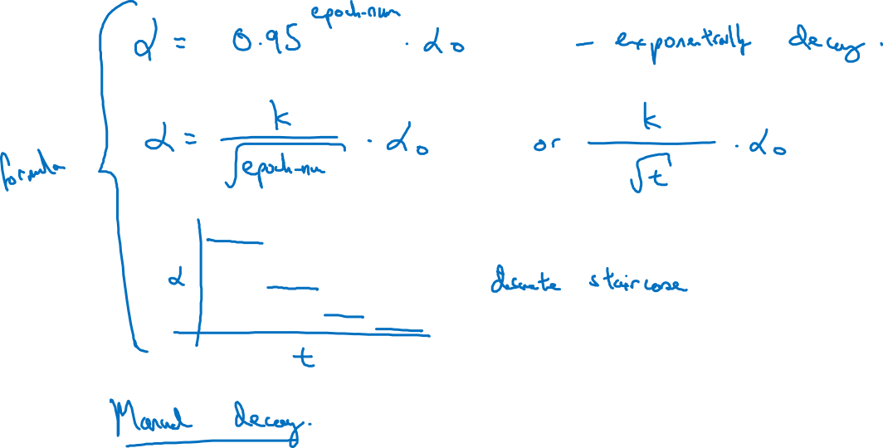
Other learning rate decay methods

Slide 26
Optimization Algorithms
The problem of
local optima
deeplearning.ai

Slide 27
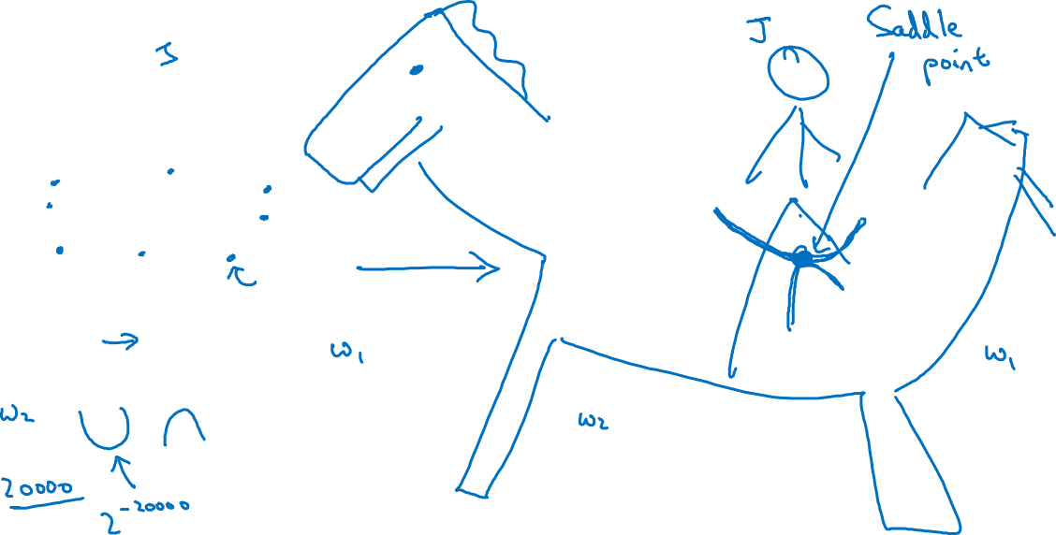
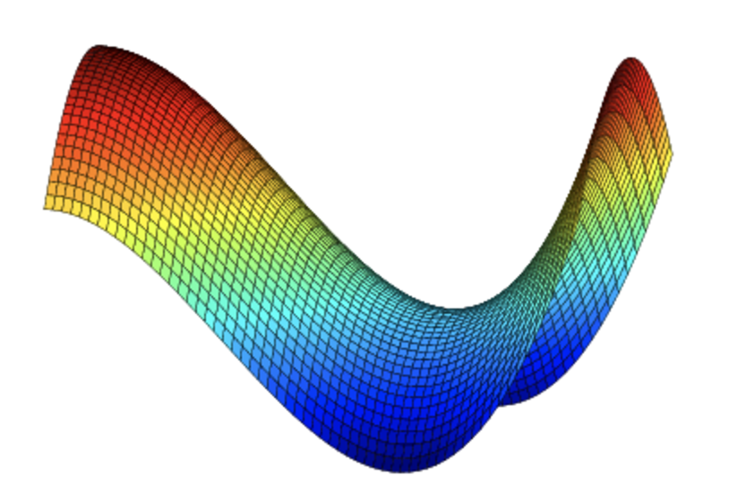
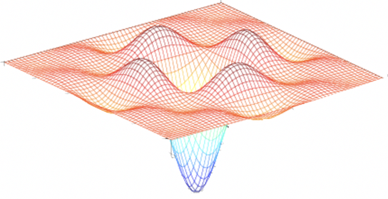
Local optima in neural networks

Slide 28
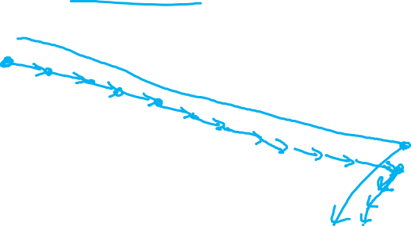

Problem of plateaus
Unlikely to get stuck in a bad local optima
Plateaus can make learning slow

